Slide 1
Employee Attrition
Analysis

Slide 2
Agenda
Introduction
Data Overview
Visualizations
Insights
Recommendations

Slide 3

Introduction
Project Title: Employee Attrition Analysis
Objective: Analyze employee attrition at XYZ Company to identify key factors contributing to attrition and provide actionable recommendations to reduce it.
Goals:
Identify trends and patterns associated with high attrition.
Provide actionable recommendations to reduce employee turnover.

Slide 4
Data Overview
Dataset: Employee Attrition Data.
Number of Records: 4410
Features: Includes attributes such as Age, Attrition, Department, JobRole, MonthlyIncome, JobSatisfaction, EnvironmentSatisfaction, WorkLifeBalance, etc.
Target Variable: Attrition (Yes/ No).

Slide 5
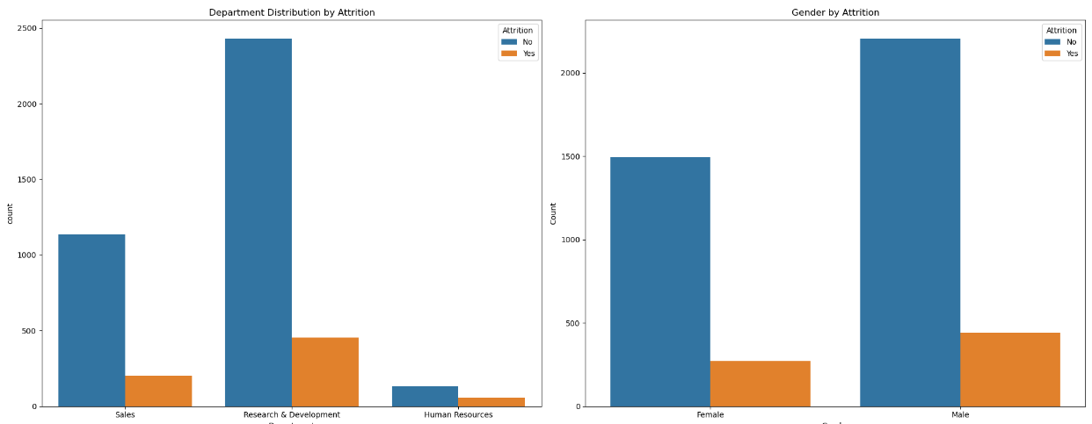
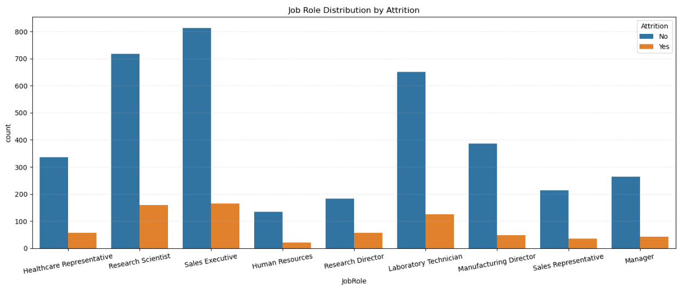
Visualizations

Slide 6
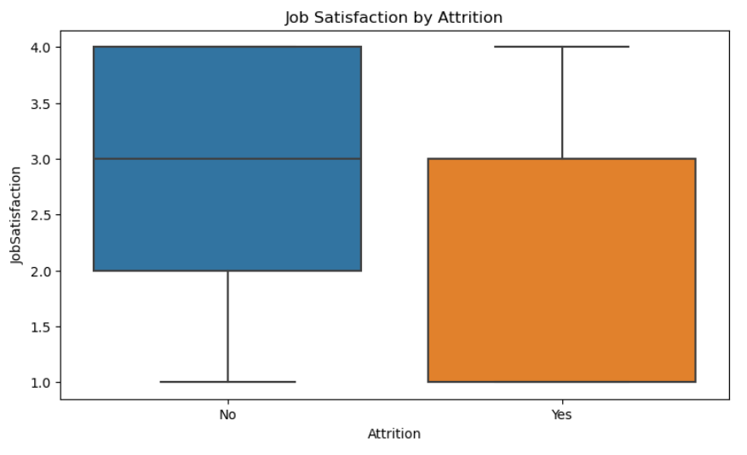
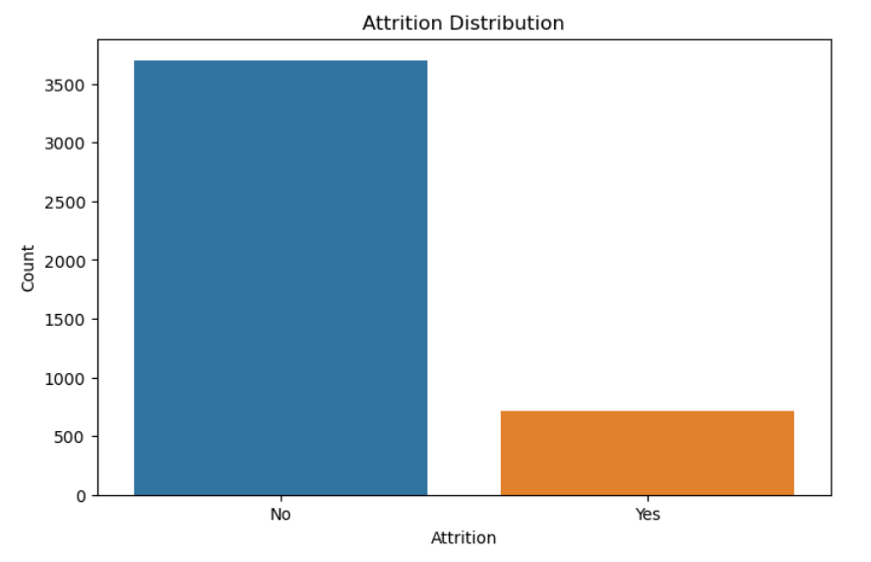
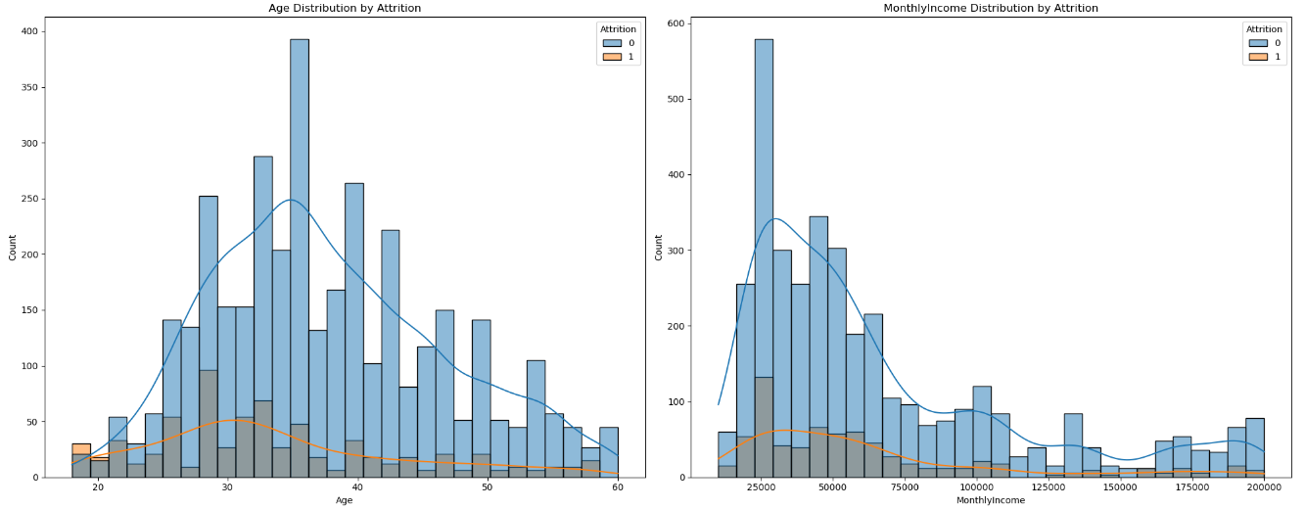
Visualizations

Slide 7
Insights
Key Factors Influencing Attrition:
Younger employees (below 35 years old) have a higher attrition rate.
Low income levels (below 60,000) are associated with higher attrition.
The Research and Development department has a higher attrition rate compared to other departments.
Sales executives and research scientists have higher attrition rates compared to other job roles.
Higher Job dissatisfaction levels often correlate with higher attrition rates.

Slide 8
Recommendations
Monitor and Improve Compensation:
Regularly review and adjust compensation packages to remain competitive and attract top talent.
Enhance Job Satisfaction:
Implement regular employee feedback mechanisms and improve recognition programs to boost job satisfaction.
Improve Work-Life Balance:
Offer flexible working hours and remote work options to address work-life balance issues.
Increase Career Development Opportunities:
Provide training and career advancement opportunities to enhance employee engagement and reduce attrition.
Address Department-Specific Issues:
Focus on departments with high attrition rates to understand and resolve specific challenges.
Implementing these recommendations can help XYZ company reduce attrition and improve employee retention.

Slide 9
Thank you

